Slide 1
Car
By: K’Vian
IED
Period 8

Slide 2
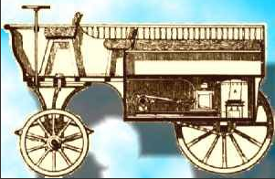
1st CARS
Nicolas Joseph Cugnot of France built the first car in 1769
The first car was powered by steam engine
Recognized by the British Royal Automobile Club and the Automobile Club de France

Slide 3
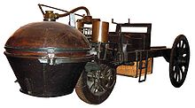
Cars were originally made of
2 in the front small rubber wheels
Steam Engine
Wooden steering wheel
Leather seats
2 big wooden wheels in the back

Slide 4
Car improvements over years
Runs off Gas
4 rubber tires
4 doors
Windows
Head lights and tale lights

Slide 5
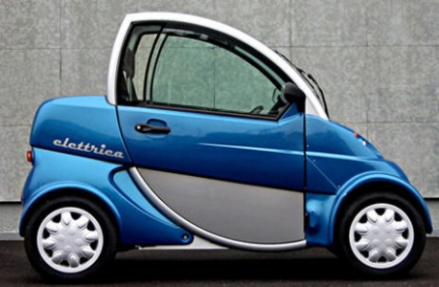
New Car improvements
petrol electric hybrids
pure electric
hydrogen power

Slide 6
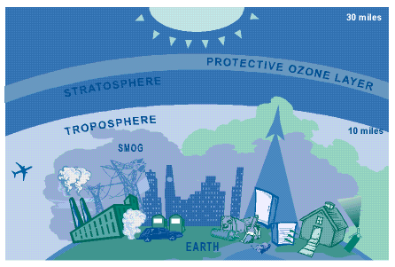
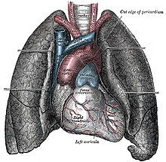
Why do we have these improvements
Keep clean lungs
Keep clean environment
Keep clean atmosphere
Less to pay

Slide 7
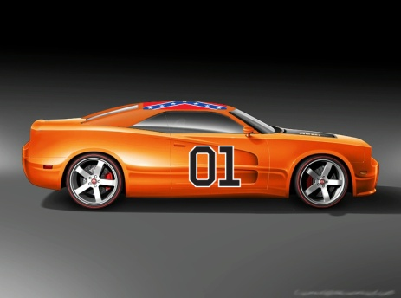
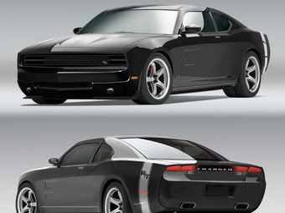
Bibliography
http://www.ausbcomp.com/~bbott/cars/carhist.htm
http://en.wikipedia.org/wiki/Nicolas-Joseph_Cugnot

