Slide 1
The Evolution Of Soccer Balls
Irnes
PLTW
8th Grade

Slide 2
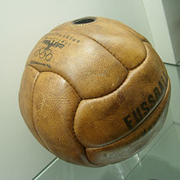
Introduction Of Soccer Balls
In 1836, Charles Goodyear helped taking the history of soccer balls one step forward, with the introduction of the first vulcanized rubber soccer ball.

Slide 3
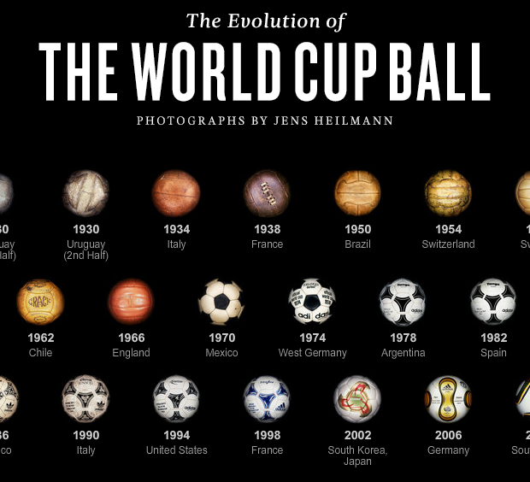
The Evolution

Slide 4
Major Changes
During the 1900s footballs were made out of rubber and leather which was perfect for bouncing and kicking the ball, however when heading the football (hitting it with the player's head) it was usually painful.
The reason why is because the ball would abosorb water and make it heavier.

Slide 5
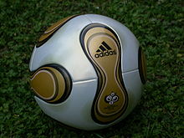
Present Developments
Elements of the football that today are tested are the deformation of the Soccer ball when it is kicked or when the ball hits a surface.
The also changed the style and leather of the ball to make it lighter.

Slide 6
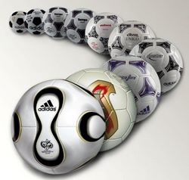
Future Developments
Companies such as Addias Nike and Puma are releasing footballs made out of new materials which promise more accurate flight and more power to be transferred to the football.

Slide 7
My Resources
http://en.wikipedia.org/wiki/Football_(association_football)
http://www.soccer-fans-info.com/history-of-soccer-balls.html
http://en.wikipedia.org/wiki/History_of_football_(soccer)_balls
http://www.soccer-n-things.com/soccer-balls/history-of-soccer-balls

